Slide 1


Digital Control in Power Electronics
杭丽君
ljhang@hdu.edu.cn
可再生能源及微型电力网技术实验室
Regeneration energy and microgrid Technology Lab(REMT)

Slide 2
课 程 内 容
Introduction: Power Electronic Converters
Introduction: Digital Control Application to Power Electronic Circuits
Introduction: Digital control of high frequency switched mode power converters

Slide 3
3.1 DIGITALLY CONTROLLED SWITCHED-MODE CONVERTERS
In high-power applications, control and monitoring tasks are often more complex, while the power semiconductor devices are operated at relatively low switching frequencies, for example, up to tens of kilohertz. The controller cost and power consumption are relatively low compared to the overall system cost and power rating. In these applications, digital control offers clear technical and economic advantages in addressing complex control, management, and monitoring tasks.
As a result, for many years now, digital control methods and digital controllers based on general-purpose or dedicated microprocessors, digital signal processor (DSPs), or programmable logic devices have been widely adopted in power electronics applications at relatively high power levels.

Slide 4
3.1 DIGITALLY CONTROLLED SWITCHED-MODE CONVERTERS
digital power in high-frequency power electronics applications:
• Ongoing advances in digital integrated-circuit processes have continued to increase processing capabilities while bringing the cost down.
• The needs for improved system integration and increasingly complex power management and monitoring functions have translated into the needs for digital interfaces and programmability in switched-mode power conversion applications.
• Practical high performance digital control techniques have been introduced and demonstrated, together with innovative approaches offering performance gains or entirely new capabilities that would be difficult or impractical to realize using traditional analog techniques.

Slide 5
3.1 DIGITALLY CONTROLLED SWITCHED-MODE CONVERTERS
Digital power management
control algorithms are designed and
implemented in code executed on general-purpose or specialized microcontrollers or DSP chips.
Digital control
digital power
Software-based controllers
Digital implementation techniques
custom-integrated circuits or programmable logic devices such as field-programmable gate arrays (FPGAs).
Hardware-based controllers

Slide 6
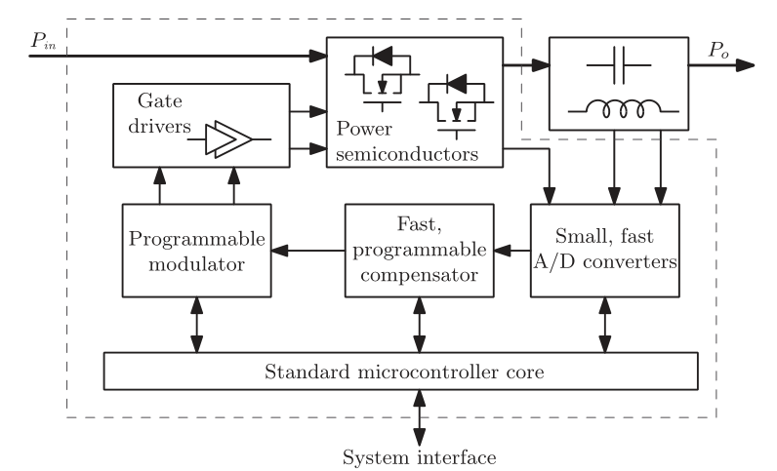
3.1 DIGITALLY CONTROLLED SWITCHED-MODE CONVERTERS
Digital controller architecture for high-frequency switched-mode power converters

Slide 7
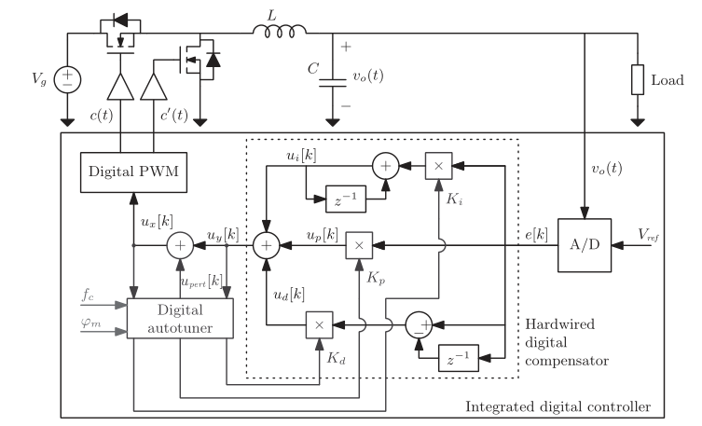
3.1 DIGITALLY CONTROLLED SWITCHED-MODE CONVERTERS
Digitally controlled point-of-load (POL) synchronous Buck dc–dc converter
example. Including analysis, modeling, design, and implementation of digital control loops, etc.

Slide 8
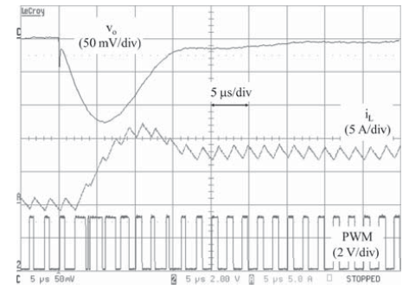
3.1 DIGITALLY CONTROLLED SWITCHED-MODE CONVERTERS
Analysis, Modeling, and Control Techniques:
the basic digital control
loop is conceptually similar to the standard voltage-mode analog PWM control
time quantization
amplitude quantization
Implementation Techniques:
regulation precision and accuracy are determined by the resolutions of A/D and DPWM blocks, which introduce amplitude quantization effects Digital compensator implementation
PID compensator structures
Experimental 0 to 8 A load step response in a digitally controlled POL Buck converter with conventional PID compensation.

Slide 9
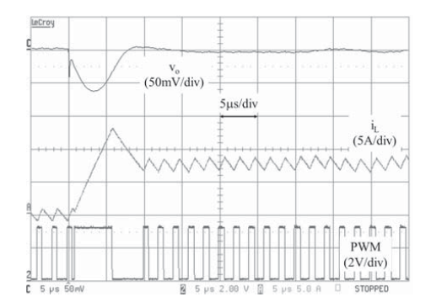
3.2 SYSTEM AND PERFORMANCE GAINS VIA DIGITAL CONTROL
Increased flexibility
Programmability
integration of system interface power
management functions
Improved Dynamic Responses
Experimental 0 A-8 A step load response in a digitally controlled POL Buck converter with the time-optimal controller

Slide 10
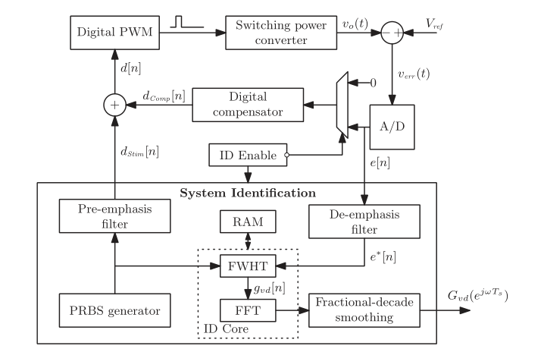
3.2 SYSTEM AND PERFORMANCE GAINS VIA DIGITAL CONTROL
Integration of Frequency-Response Measurements
Digitally controlled PWM converter with integrated frequency response
measurement capabilities

Slide 11
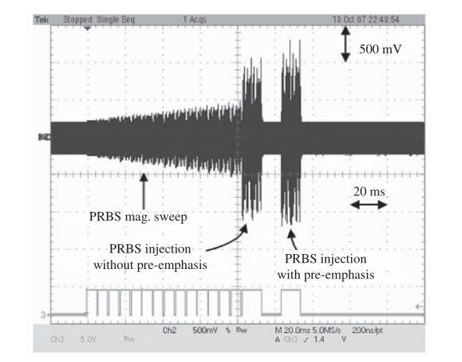
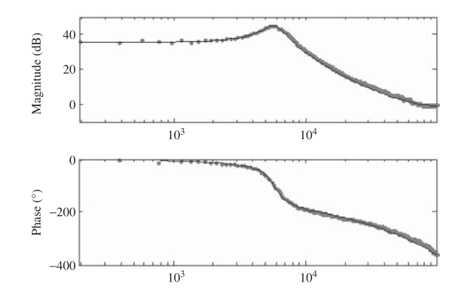
3.2 SYSTEM AND PERFORMANCE GAINS VIA DIGITAL CONTROL
Autotuning & Efficiency Optimization
Control-to-output magnitude and phase responses determined by the system identification process
Output voltage during system identification process in a 15- to 30-V Boost dc–dc converter operating at fs=195 kHz

